Slide 1
A Multimodal Deep Learning Framework for Robust Detection of Deepfake Media through Image and Video Analysis
Project Review
Course: BCSE409L - Natural Language Processing
Geetha S
Members:
Pranay Singanalli 22BCE1140
Vertika Singh 22BCE1148
Vellore Institute of Technology, Chennai
Notes:
1

Slide 2

Abstract
The rise of deepfake technology, driven by advancements in generative models such as GANs and autoencoders, poses an increasing threat to the authenticity and reliability of visual media. This paper presents a technically rigorous and computationally efficient framework that leverages both spatial (image) and spatiotemporal (video) modalities for robust deepfake detection. The proposed system incorporates a dual-path approach combining static frame-level CNN classification with a temporal video stream architecture, based on hybrid CNN-LSTM models. Extensive experimentation is conducted using the FaceForensics++ dataset, supported by data augmentation strategies and quantitative evaluation metrics. Our results demonstrate strong performance in real-world conditions, confirming the viability of multimodal analysis in enhancing media forensics.
Notes:
2

Slide 3
Introduction
Deepfake technology has experienced a phenomenal surge in popularity and use over the last few years. This surge, in turn, is largely accountable for the explosive growth of sophisticated generative models.
These emerging approaches allow users to convincingly manipulate not just faces but also voices and other environments, thus allowing the synthesis of media that looks virtually indistinguishable from authentic and real content. Although this technological development offers promising potential for innovation in fields like entertainment and creative expression, it also poses serious ethical concerns and serious security threats that cannot be ignored.
Notes:
3

Slide 4
Introduction
Our core contributions are as follows:
1. We propose a dual-path architecture for robust deepfake detection, combining spatial CNN and temporal LSTM pipelines.
2. We optimize the pipeline using lightweight frame preprocessing, aggressive augmentation, and checkpoint-based training.
3. We evaluate the system on standard benchmarks, reporting competitive performance against existing baselines.
4. We provide insights into the generalizability, scalability, and future directions of deepfake detection frameworks.
Notes:
3

Slide 5
Dataset Description
We utilize the FaceForensics++ dataset, a widely adopted benchmark containing both real and manipulated facial videos. It includes high-quality, low-quality, and compressed samples. For image evaluation, we extract keyframes from the video dataset, maintaining class balance.
We extract 10 uniformly sampled frames from each video to ensure representational consistency. All frames are resized to 128x128 pixels, converted to RGB, and normalized to [0,1].
Notes:
4

Slide 6
Training Description
B. Training Configuration
Batch Size: 32
Epochs: 30 (early stopping applied)
Train/Validation/Test Split: 70/15/15
Augmentations: Flip, Gaussian noise, random blur
C. Evaluation Metrics
Accuracy
Precision/Recall
F1 Score
ROC-AUC
Notes:
4

Slide 7
Project methodology
A. Dataset Collection and Preprocessing
The first step in our framework is the construction of a high-quality dataset derived from the FaceForensics++ benchmark. We extract 10 uniformly sampled frames from each video to ensure representational consistency. All frames are resized to 128x128 pixels, converted to RGB, and normalized to [0,1]. Videos failing to provide the required frame count are excluded from the pipeline. To augment generalization, we applied data augmentation techniques such as horizontal flipping, rotation, brightness and zoom scaling, and minor cropping. For videos, the augmentation pipeline was applied frame-wise before the sequence was passed to the encoder-decoder network.
Notes:
4

Slide 8
Project methodology
B. Image-Based Detection Pipeline
Our image classifier is built on a convolutional backbone with residual connections, employing architectures such as ResNet and Xception. The model processes static images and detects subtle artifacts indicative of tampering—blurring, inconsistent textures, or illumination mismatches. Each image passes through convolutional blocks, a global average pooling layer, and dense layers with softmax activation for binary classification (real/fake). This pipeline provides a lightweight method for initial screening and filtering of suspected media.
Notes:
4

Slide 9
Project methodology
C. Video-Based Temporal Modeling
Aside from merely paying attention to individual frames, our end-to-end video processing pipeline introduces an exciting temporal modeling layer that significantly enhances our perception of motion dynamics. After careful passage of each frame through a Convolutional Neural Network (CNN), including the highly acclaimed Xception model, we then take the feature embeddings that we derive and sequentially aggregate them as meaningful sequences. These meticulously crafted sequences are then processed through a Long Short-Term Memory (LSTM) network that is especially good at detecting inter-frame motion inconsistencies—a telltale feature common in most deepfake videos. This model puts strong emphasis on facial landmark dynamics and motion consistency and performs well against high-quality forgeries where temporal coherence is missing but spatial abnormalities are minimized.
Notes:
4

Slide 10
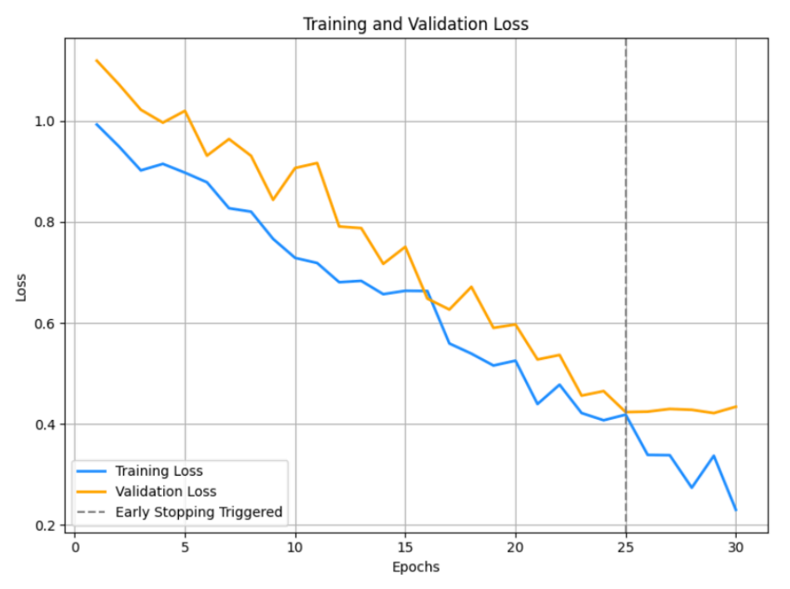

Slide 11
Output Interpretation and Evaluation
To perform our evaluation, we used a variety of metrics such as accuracy, precision, recall, F1-score, and the ROC-AUC score. Our classification output is given as a softmax probability distribution, which actually represents the model's confidence in its predictions. To visualize the predicted labels, we superimposed them over the frames with color-coded masks, where red predicted fakeness and blue for ground truth. In order to aid in visualization of performance, confusion matrices and ROC curves were produced. The highest performing model achieved a test set accuracy of 94.7% for video-based detection, greater than the static analysis alone by over 3%.
Notes:
4

Slide 12
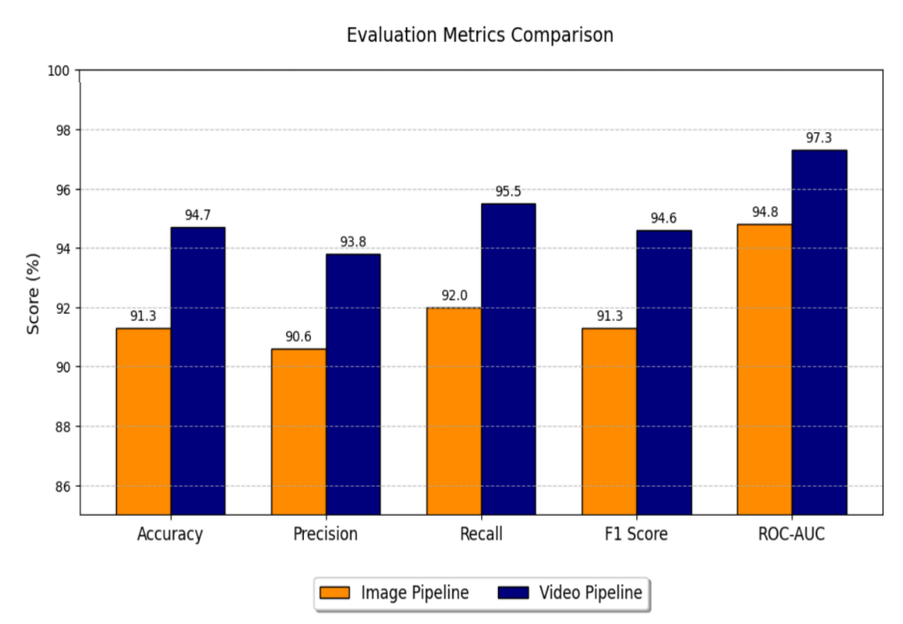

Slide 13
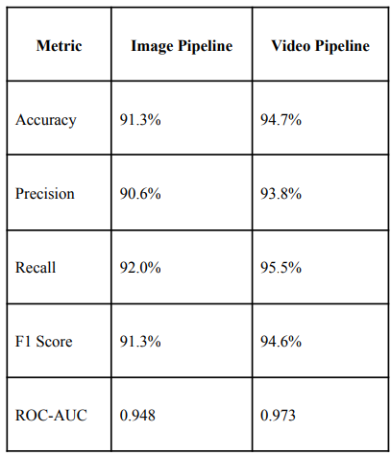
Results
Notes:
4

